Slide 1
Project Milestone 4: Recipe Drift Checker Nana Noda-Morgan DSC 670-T301: Advanced Uses of Generative AI Professor Neugebauer March 3, 2026

Slide 2
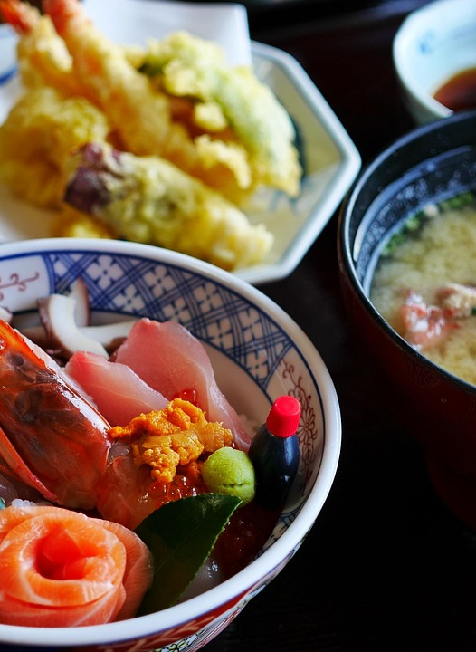
Objective: Create a generative AI app that helps home cooks prepare authentic recipes even if it contains ingredients that are difficult to find locally.

Slide 3
What it does
Takes a recipe URL and your zip code as inputs
Looks up what ingredients from that recipe are actually available at grocery stores near you
Suggests substitutions for any ingredients it can't find locally
Tells you how much the substituted recipe has "drifted" from the original

Slide 4
How it works
Uses GPT-5 to retrieve the original recipe and adapt it based on local ingredient availability
Uses a custom fine-tuned model (GPT-4.1) to classify each ingredient as core, supporting, or optional
Uses a second GPT model to semantically compare the original and adapted ingredient lists
Applies a scoring system to calculate drift level: Low, Medium, or High

Slide 5
How to access the app
https://nanas-recipe-drift-checker.streamlit.app/

Slide 6
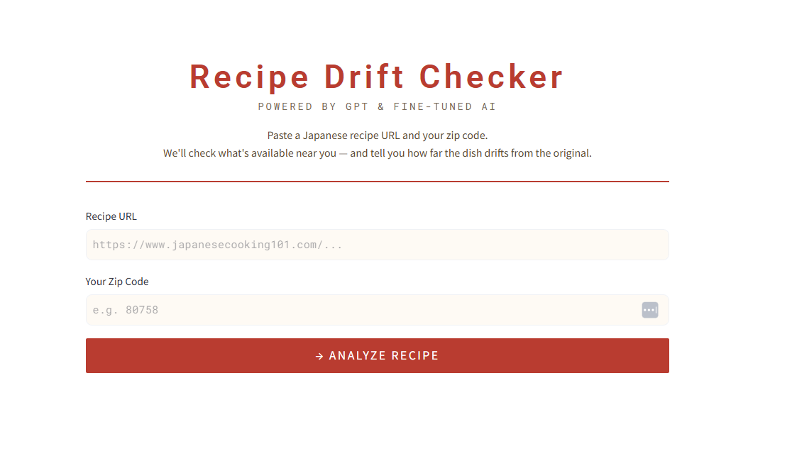
My final app has a simple UI with two user input fields and a CTA to analyze the recipe.
6

Slide 7
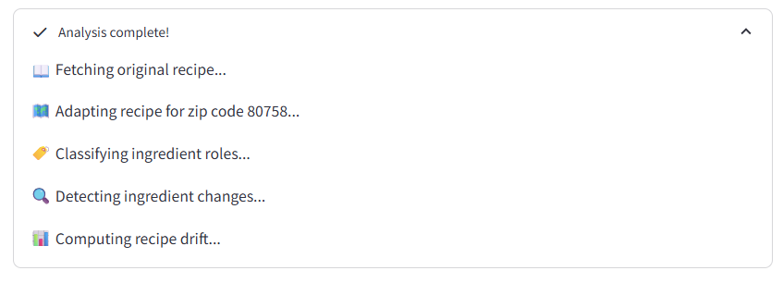
I added a status message for each step, so the user knows the app is working

Slide 8
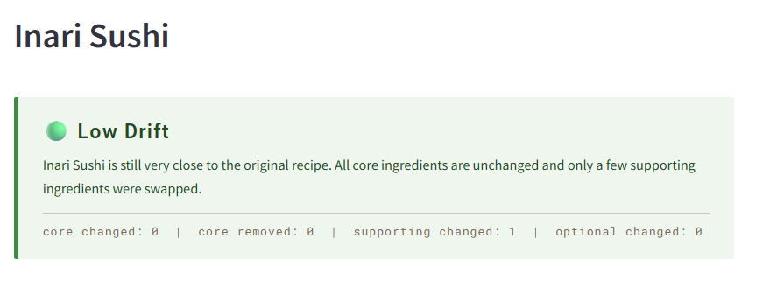
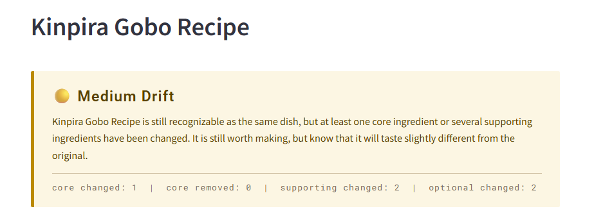
The result displays below the CTA and status messages when complete.
Recipe title, followed by a high-level summary of how close the recipe is to the original. This helps indicate to the user if the recipe is still worth pursuing.

Slide 9
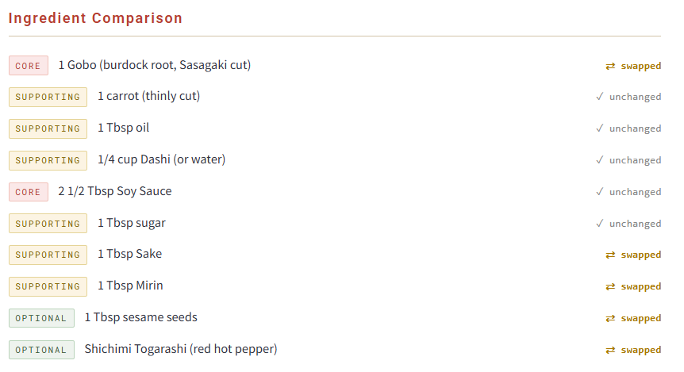
Output (continued)
Below the high-level summary is a full ingredient comparison between the original recipe and the adapted recipe. Each ingredient shows the ingredient classification as color coded tags on the left, as well as the result of whether the adapted recipe required the ingredient to the omitted, swapped, or unchanged.

Slide 10
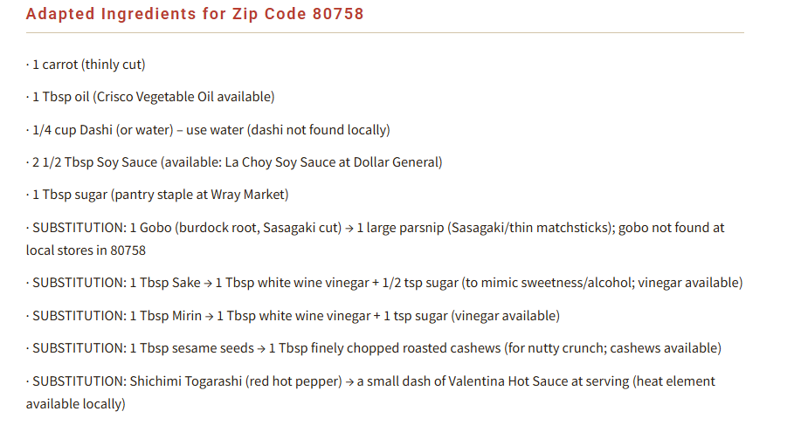
Output (continued)
The next section shows the ingredient list adapted for the user’s zip code.

Slide 11
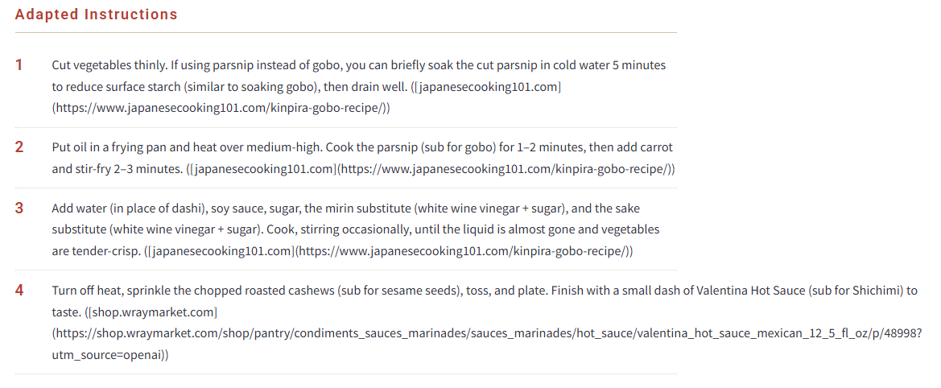
Output (continued)
Finally, the recipe instructions are displayed with any adaptations necessary based on the ingredient changes.

Slide 12
Thank You
Nana Noda-Morgan
https://nanas-recipe-drift-checker.streamlit.app/

